Slide 1
AMZL Onboarding – Day 2
DDC2
Rockville, MD

Slide 2
Introduction to HR
How Human Resources helps us

Slide 3
Associate Engagement
How to Engage with Associates, DPs and DAs
Associate Engagment Video with John Deery Schmidt

Slide 4
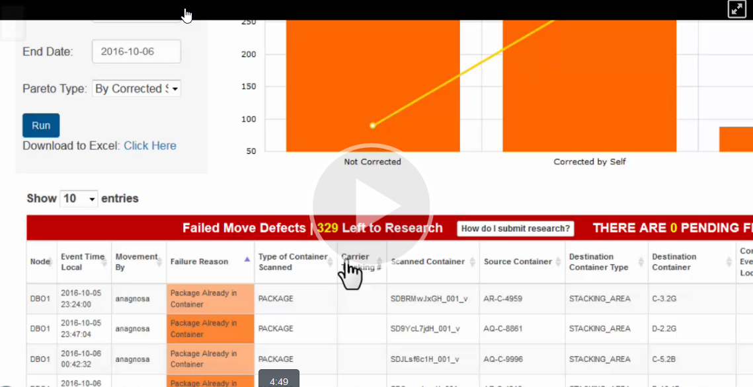
C3PO Failed Moves Tutorial
Watch the Video

Slide 5
DSP Portal and DSP Engagement

Slide 6
DSP Management / Contractor Relations
Flex and Same Day
Performance Manager - DSP Performance
Comm & Engagement - Communicating with DSPs
Supplier Compliance - DSPs are in compliance with policies
Support Teams for DSPs
Account Managers - Procuring, negotiating, onboarding DSPs

Slide 7
Routing Tool Website
Route Planner, Auto Assign, Picklist

Slide 8
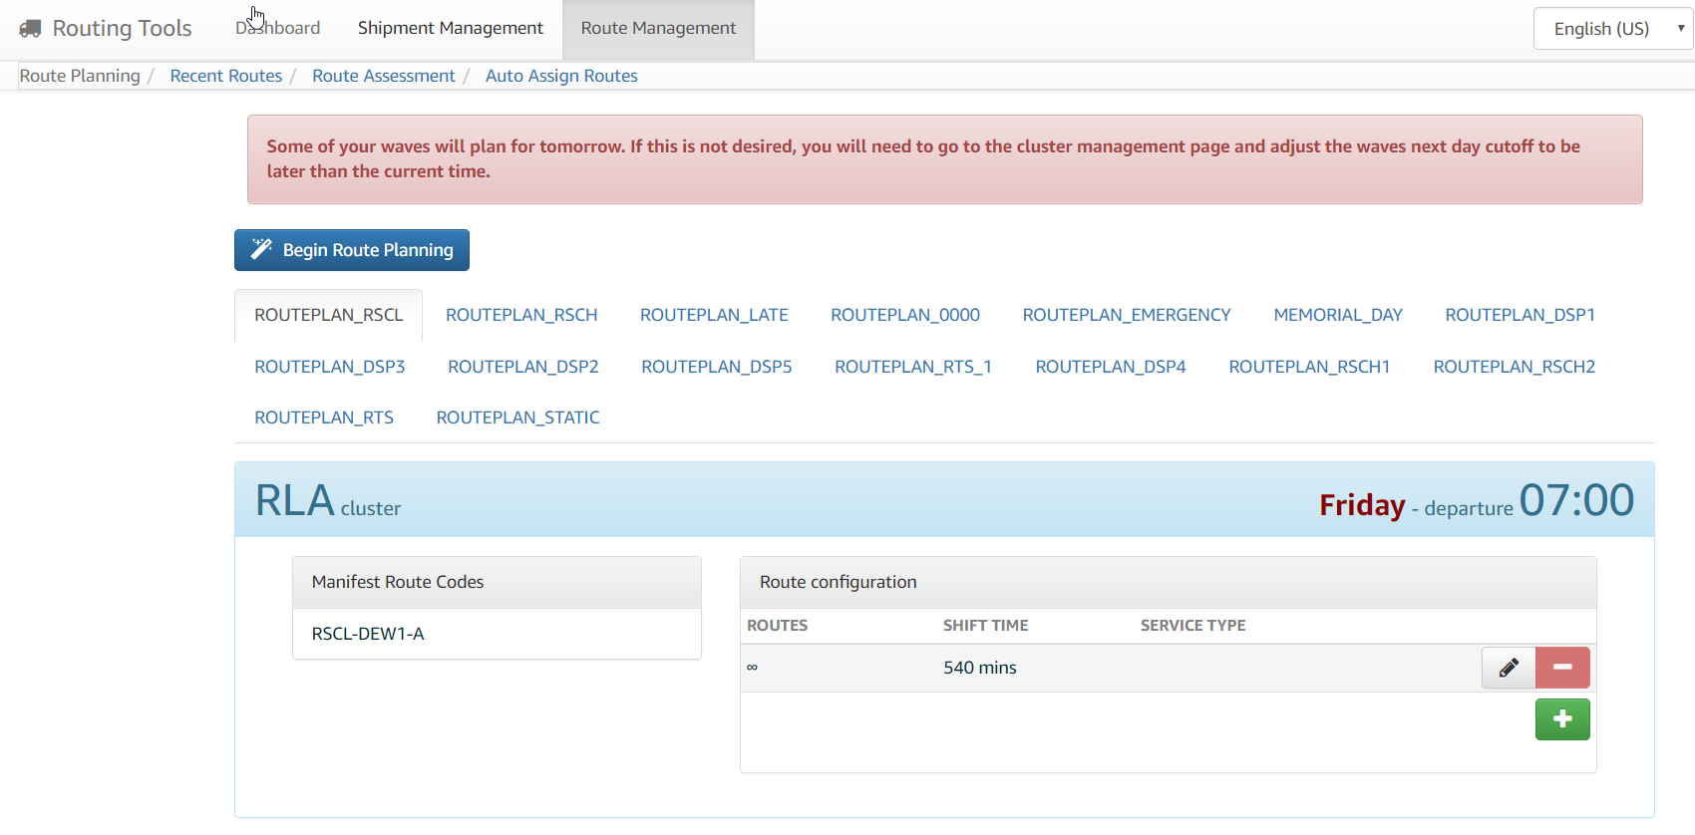
RTW – Route Planner

Slide 9
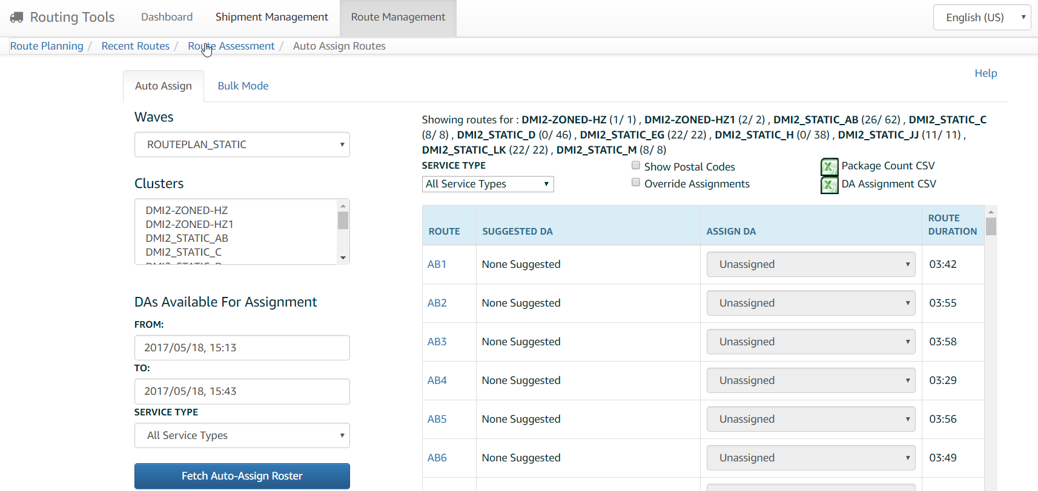
RTW – Auto Assign

Slide 10
COMP
Carrier Operations Management Platform

Slide 11
COMP and RTW
Bookmark these!
compwebsite-na.amazon.com
routingtools-na.amazon.com

Slide 12
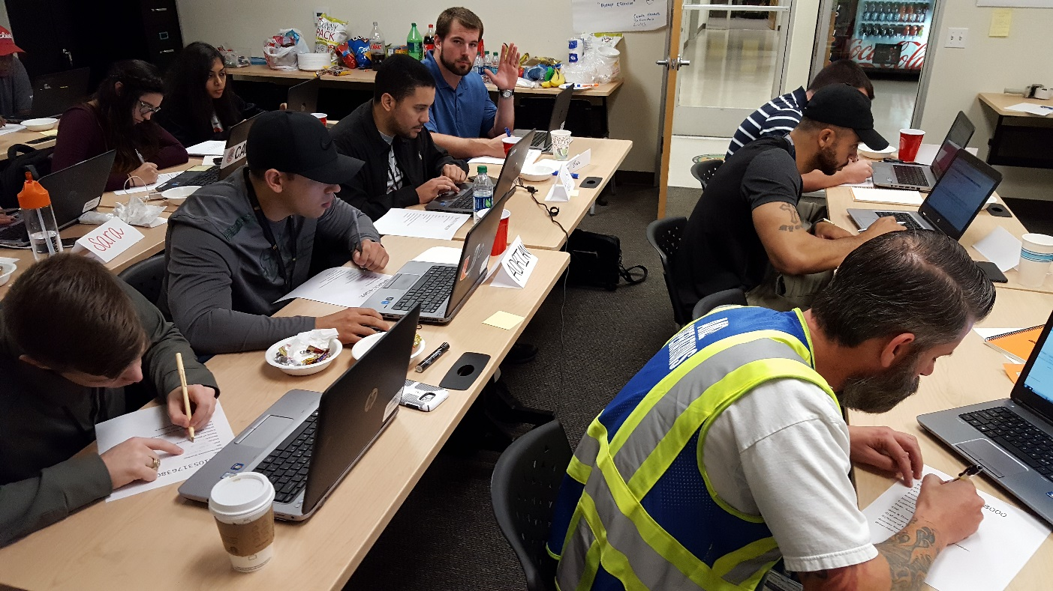
COMP-etition
Activity
You will be given a TBA number
You must use COMP to look up all the information
Each item must be filled out
First team to have all members finish wins
When you have the correct answers checked, you may help your teammates

Slide 13
RTW – On Road Monitoring
Routing Tools Website

Slide 14
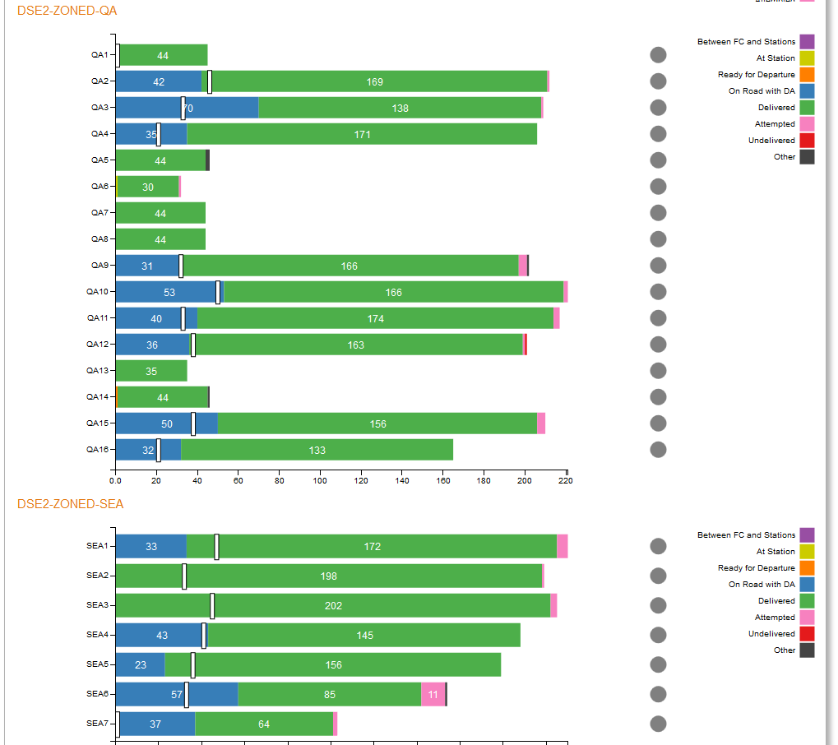

RTW – On Road Monitoring
Up and Running with Routing Tools
eLearning

Slide 15
Routing Tool-etition
Activity
You will be given a route/stop number
Use the RTW to look up the TBA number
You must use the RTW and COMP to look up all the information
Each item must be filled out
First team to have all members finish wins
When you have the correct answers checked, you may help your teammates

Slide 16
DA Onboarding Curriculum
Finish the curriculum

Slide 17
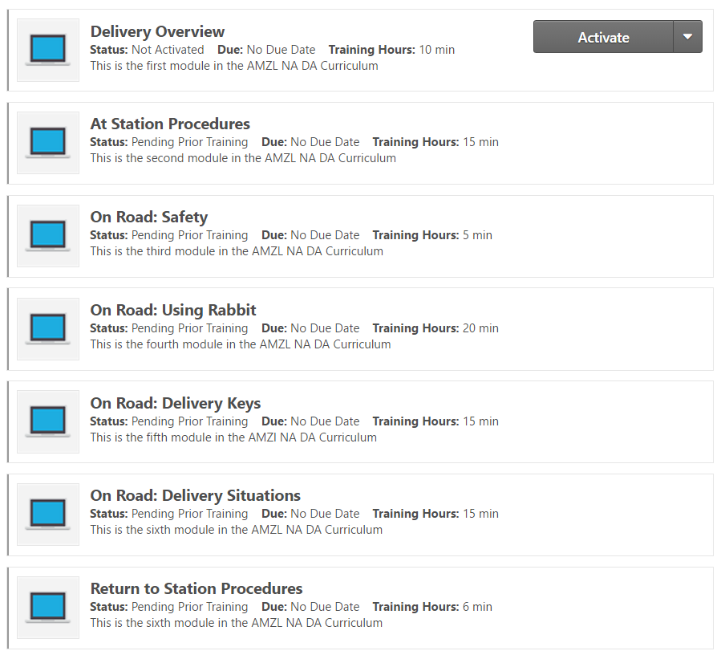
AMZL Delivery Associate Onboarding Curriculum
Who takes this curriculum?
Access the curriculum through your Agenda
MUST finish this course before your Ride Along

Slide 18

Lunch/DA eLearning

Slide 19
Rabbit and the POC
Using the Rabbit App

Slide 20
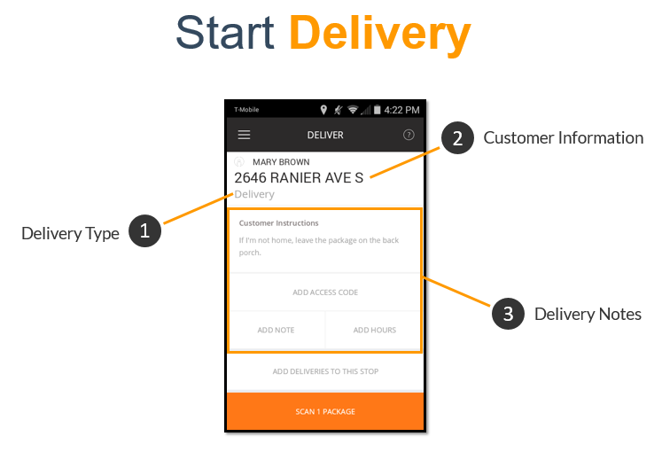
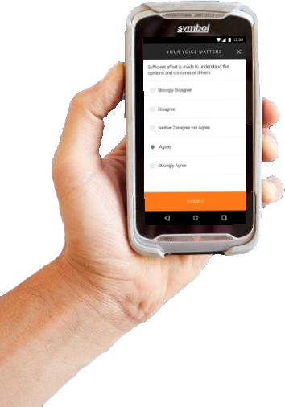
Using the Rabbit App

Slide 21
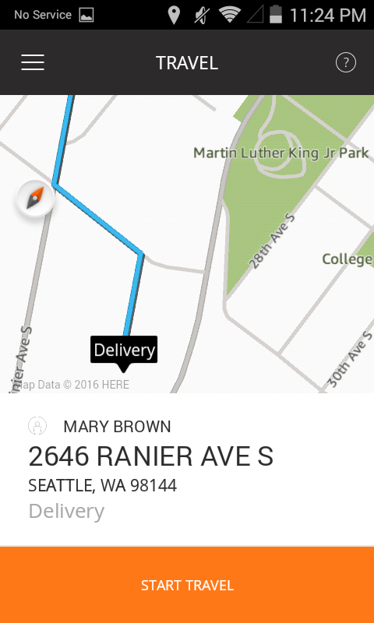


Sequence
Package Obstacle Course (POC) Activity
As a team, visit each “delivery”
Read the scenario and examine the picture for each
Determine if you can / can’t deliver the package, and if so, why
Scan the package and use the app to mark the package correctly
Rotate deliveries among the group
You will be timed!
Click for POC activity posters

Slide 22
Quality 101

Slide 23

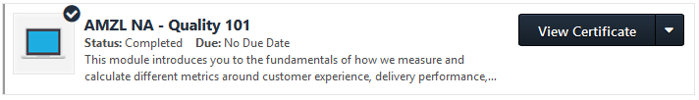
Quality 101
How we measure station performance
Key Topics Covered:
  Station Metrics
  Perfect Mile dashboard
  Concession Types
https://knet.csod.com
In Class:
AMZL NA – Quality 101

Slide 24
Geofencing
Step by step instructions on how to use different platforms to pull Geo Code data

Slide 25
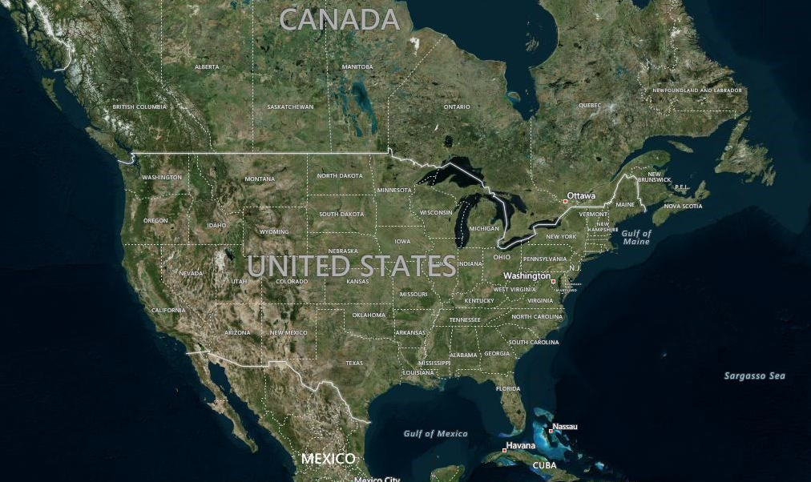
Geo Data Editor
Broadcast Video
Geodata/Geofencing Video

Slide 26
Permissions & Trouble Tickets
Access to tools and communications for help

Slide 27
Permissions
How to get permissions
Learning Coordinator
Regional Learning Manager
Launch team
Ops manager
Designated site admins
amzlpermissions@amazon.com
https://permissions.amazon.com/
Group Detail
User Detail

Slide 28
Trouble Tickets
How to get permissions
Use RIVER to submit TT
Use TT site to monitor open tickets
Search previous trouble tickets
Quicklinks
Correspondence
Resolving trouble tickets
Adding images/screenshots
Sev (Severity) levels 1-5
VOC Team (Escalations)
RIVER (Tutorial)
https://tt.amazon.com/

Slide 29


Ride Along
Dos and Don’ts
DO be involved in the process and experience the whole day
DO buy your DA lunch/coffee, etc.
DO ask them questions, have conversations with them and learn about their barriers/opportunities
DO wear comfortable clothing as you will be walking, moving, carrying a lot throughout the day
DO call the customer, call TOC when you’re delivering, so you can experience those processes
DO give the best customer service possible, feel free to introduce yourself to the customer, but don’t hold up the DA
DO take notes on your experience and fill out the DA audit form
DO NOT post any pictures on social media
DO NOT just sit in the van all day long
DO NOT inconvenience the DAs at all!
DO NOT tell them what to do or change – instead ask them questions or say ‘well when do you use WMYC’
DO NOT ask the DA to drop you off at the hotel if it’s not directly on the way back. Uber, taxi, or contact another associate on What’s App?

Slide 30

Homework
Homework:
Set your alarms! Be at DEW1 by 6:15am for ride alongs
Make sure you have finished DA eLearning Curriculum

