Slide 1
AMZL Onboarding
DLA5
Riverside, CA

Slide 2



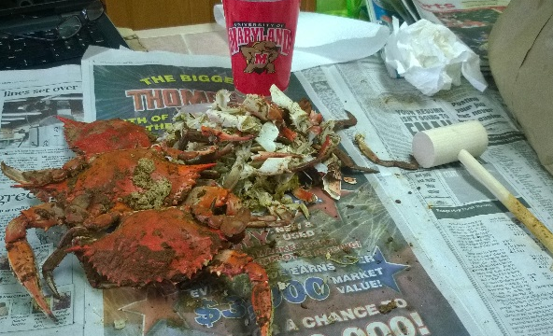

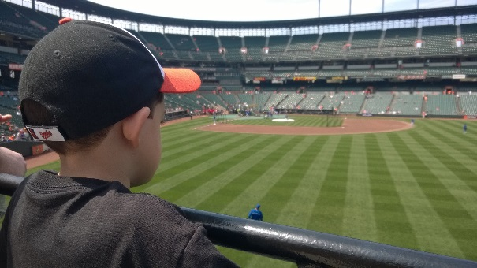

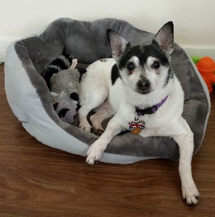
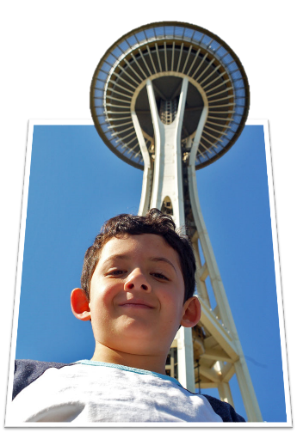

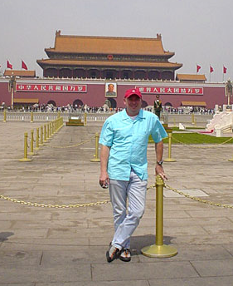
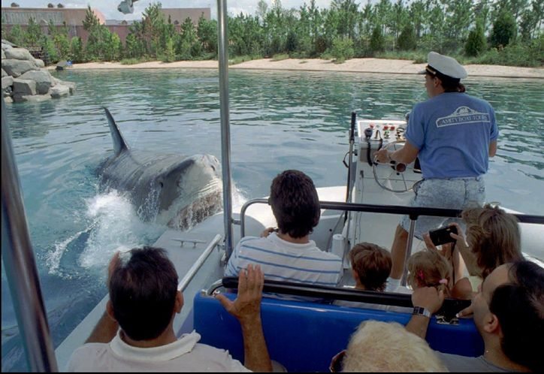
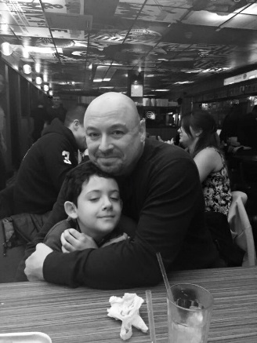
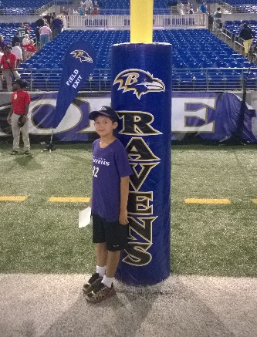
About Me
Started Jan 4, 2015
All with AMZL
“COMP-Man”
Launched 20 stations
Lived in: Baltimore, Orlando, Atlanta,
Phoenix, Bentonville, AR, Leeds, UK
Worked for: Walmart, Hitachi, U-Haul, Johns Hopkins, Thomson Learning, CNN.com, Cartoon Network, Universal Studios
Jeff Clay (clayjeff@)

Slide 3
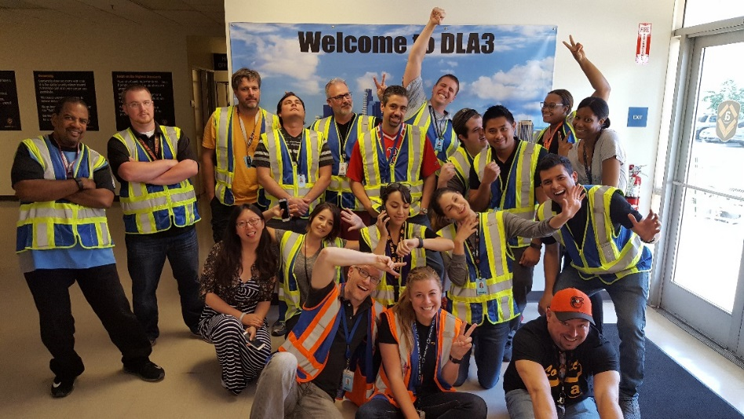
Welcome
to AMZLO!
INTRODUCTIONS/GROUPS
HOUSEKEEPING
CHIME
UBER / RECEIPTS
SOCIAL DIRECTOR
MVP
AGENDA / SCHEDULE
CONTACT/SPEAKER LIST
A TO Z GUIDE
DO’S & DON’TS

Slide 4
OBJECTIVES
Identify current and future projections for Amazon Logistics
Demonstrate basic understanding of AMZL technology and tools
Recognize the working relationship between Amazon associates and third party contractors
Identify and explain the performance based metrics of a Delivery Station
Experience the delivery process from the point of view of a Delivery Associate
Demonstrate knowledge of AMZL terminology and processes

Slide 5

ICEBREAKER
Activity
Name
Position
Location
Favorite toy – connection to AMZLO

Slide 6
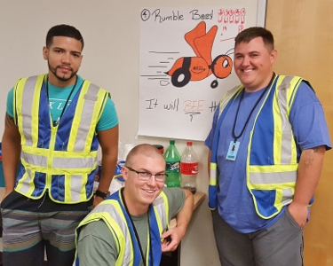
Group Activity
You’re teaming up!
Pick a team name related to AMZL
Create a slogan
Create a logo

Slide 7
How to Lead an Effective Stand Up
Leading the daily stand up

Slide 8
Lead an Effective Stand Up
Group Activity
Start a SUM with:
A Standard Work tip (e.g., every package needs a scan)
A safety tip (e.g., never place packages or containers on the top rack)
A success story (e.g., we exceeded our PPH goal yesterday)

Slide 9

Understand AMZL as a Business
Kevin Connelly, Director, Regional Ops AMZL NA

Slide 10


AMZL History and Growth
Delivery Methods
Key Topics Covered:
  AMZL growth
  Technologies and process launched in 2016
https://knet.csod.com
Day 1:
AMZL NA – Timeline and Milestones

Slide 11
AMZL – Latest Data from WBR
(Week 28, 2017)
Stat | Week 21 - Actual | Goal
% FDS (First Day Delivery Success
% Attempted Within EAD
% Delivery Success
Completed Routes (DA / DP)
Inducted Shipments
Delivered Shipments
UTA / UTL
Cost Per Shipment
Lost Shipments
Concessions DPMO
98.08% | 98.00%
96.16% / 99.20 (Cont) | 99.00% / 99.80%
97.94% | 97.00%
49,075 / 113,023
9,565,840
10,140,626
54,653 / 16,949
3.35 / 4.18 (SC) / 4.28 (C)
26,306 | 0
3,760 / 2,021 (DNR) | 3,000 / 2,000
Notes:
The numbers in the right column will appear one by one

Slide 12
Latest Stats
AMZL All Hands Meeting – June ‘17
WW AMZL
Network share 17.82%
Global DS’s from 85-110 YTD
36 Million packages
$4.12 CPP
Delivered DEA 96.46%
60 Stations in NA
Package deliveries by 2020: 7.5B

Slide 13
Who Else Does Last Mile?
The journey of a package

Slide 14
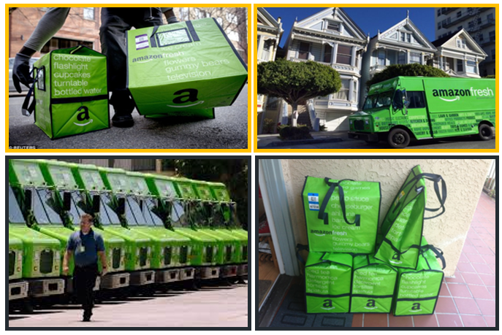
Amazon Fresh Delivery
Pantry
Fresh

Slide 15
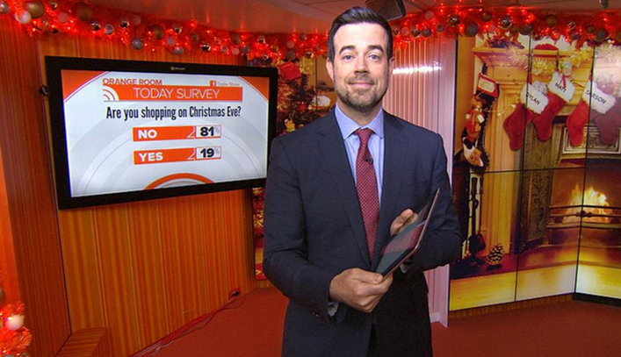

Prime Now Test - 2014
Today Show – 12/24/2014

Slide 16
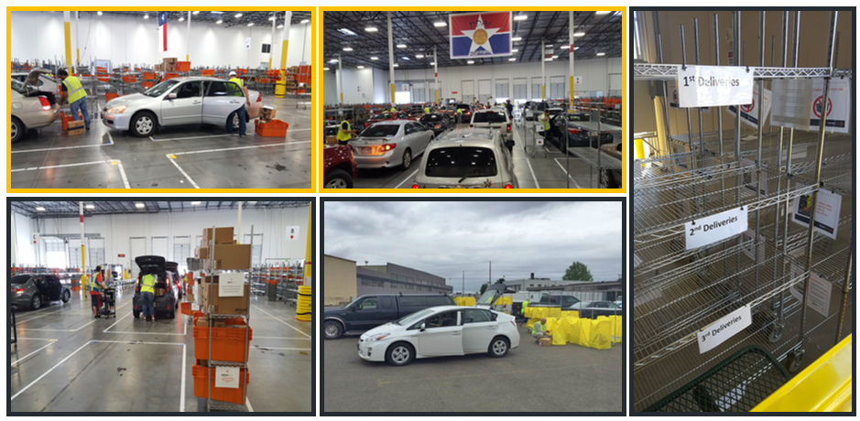
Amazon Flex

Slide 17
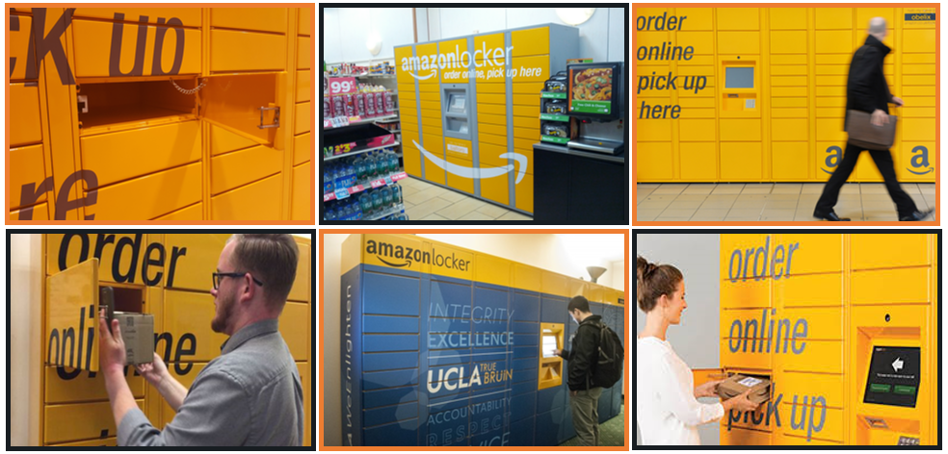
Lockers

Slide 18
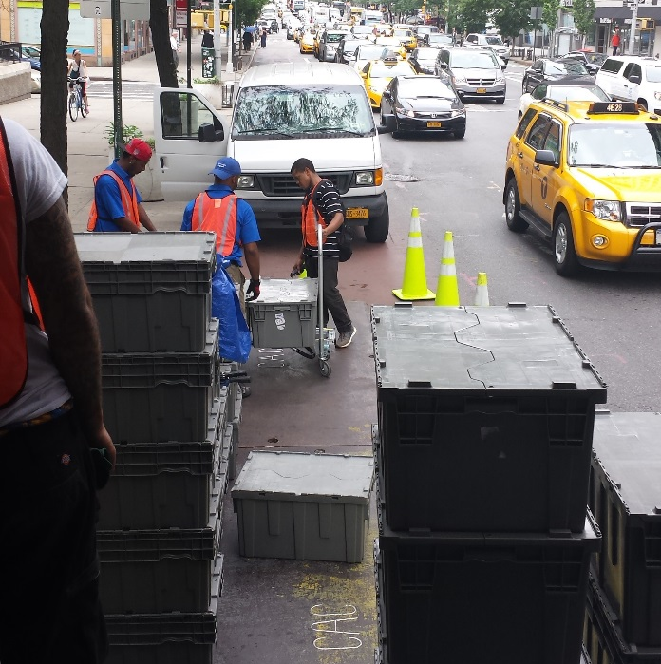
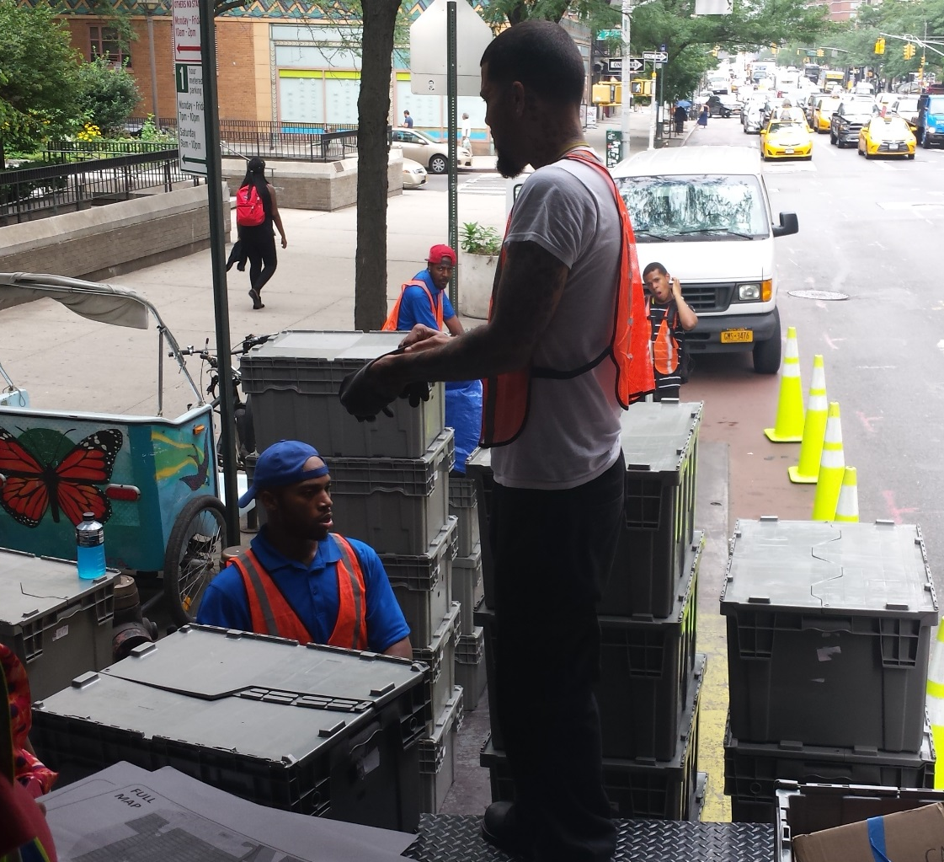
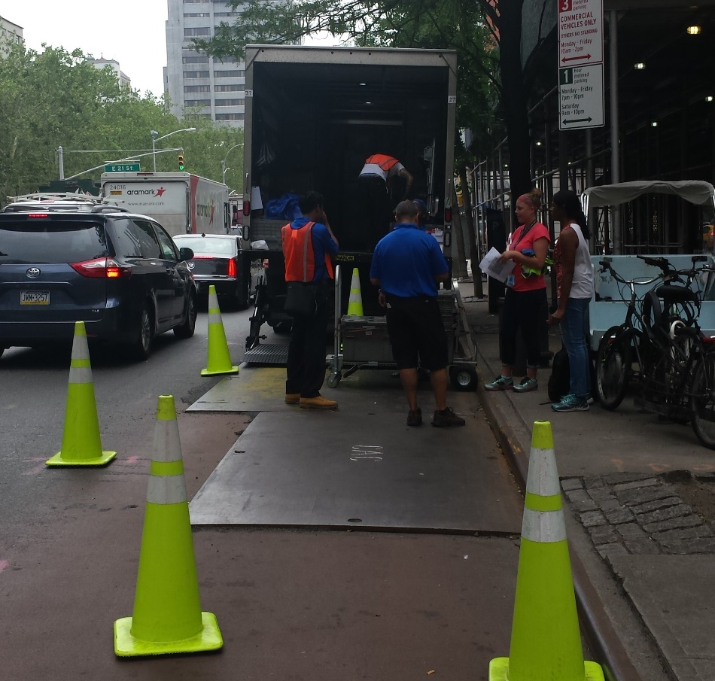
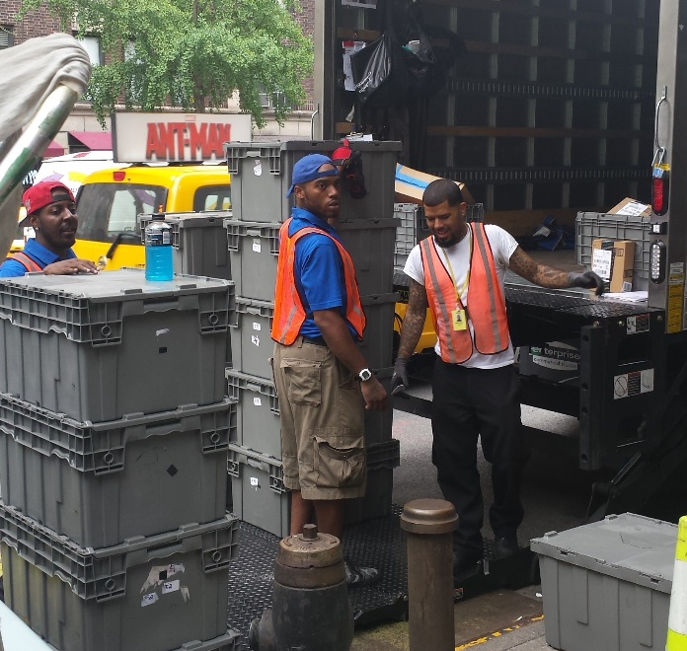
Walkers

Slide 19
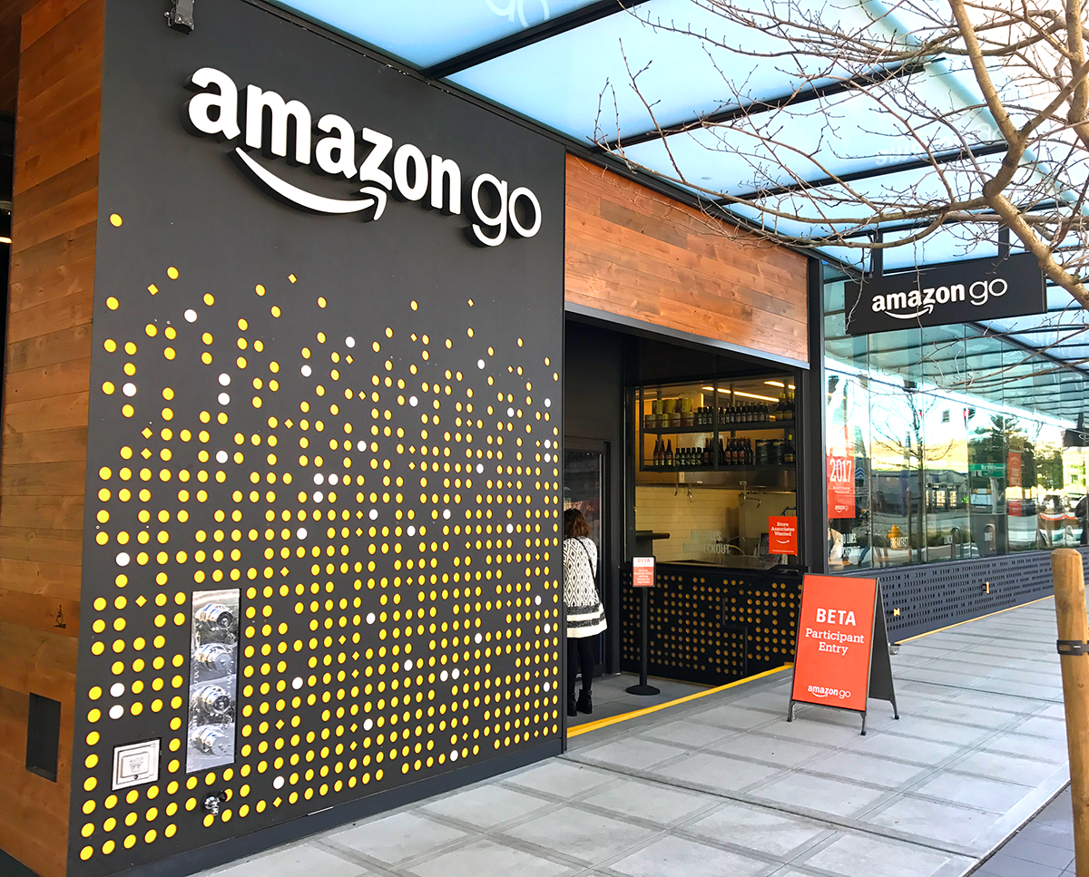
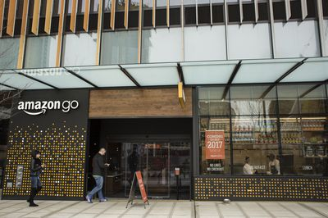
Amazon Go
No checkout
Scan your app when you walk in.
Take what you want off the shelf and it’s added to your cart
Put back what you don’t want and it’s removed
Just walk out and your Amazon account is charged
Fresh items made daily
Beer/Wine
Ready made meals

Slide 20

Different Delivery Types

Slide 21

Different Delivery Types
Key Topics Covered:
  DAs / DPs
  Time of deliveries
https://knet.csod.com
In Class:
AMZL NA – Different Delivery Types

Slide 22
24 Hour Operational Clock
Delivery Station Timeline

Slide 23


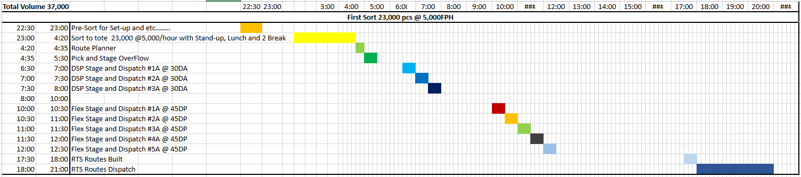
24 Hour Clock
DPD1 Clock
Day 1
24 Hour Clock eLearning Module

Slide 24
Sequence
Activity
Organize the process cards in the order of the 24 hour clock, along with the tools used to perform the process.
PROCESS
STATUS
REASON
TOOL

Slide 25




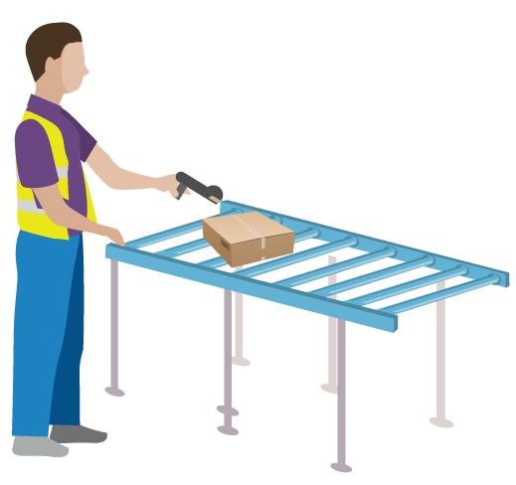
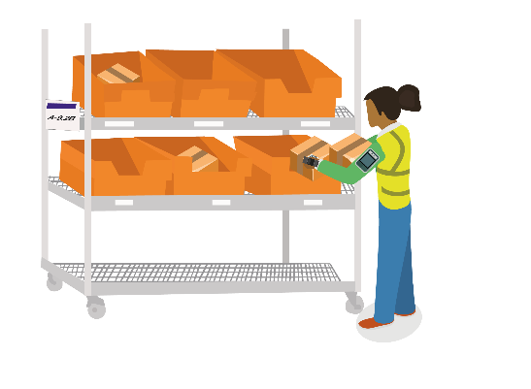

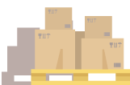







FULLFILLMENT CENTER (FC) /
SORT CENTER (SC)
LINE HAUL –
“BETWEEN FC & STATION”
DELIVERY STATION (DS)
UNLOAD
RECEIVE
“AT STATION”
SORTATION (SSP)
“READY FOR DEPARTURE”
RUN ROUTE PLANNER AND ASSIGN ROUTES
“AT STATION/READY FOR DEPARTURE”
DAs DEPART
“OUT FOR DELIVERY”

Slide 26
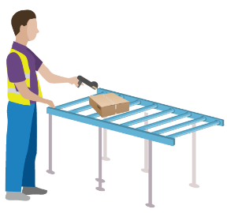

MANIFESTED
“BETWEEN FC & STATION”
RECEIVE
“AT STATION”
SORTATION (SSP)
“READY FOR DEPARTURE”
DEPART
“OUT FOR DELIVERY”
“FRONT DOOR”
“DELIVERED”
“BACK DOOR”
“CUSTOMER”
“RECEPTIONIST”
“ATTEMPTED”
“UNDELIVERABLE”
“NSL”
RTS
RTS
HOLD FOR
REDELIVERY
DELAYED AT
STATION
“READY FOR
FC RETURN”
“UTL”
(AFTER 3 DAYS)
“DMG”
“UTA”
“RJD”
“BC”
“HOLD FOR
CUSTOMER REQUEST”
“DEPART TO FC”

Slide 27
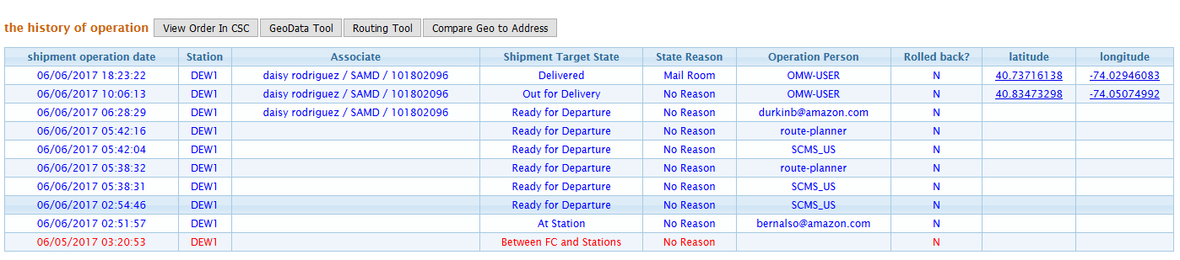
Status / Reason
Package statuses and what they mean
Delivered / Attempted / Undeliverable
Out for Delivery:
Depart
RfD:
Route Assign
RfD:
Route Planner
RfD:
Pkg Sorted/Stowed
At Station: Receive/Induct
Bet FC/Station: Manifested

Slide 28
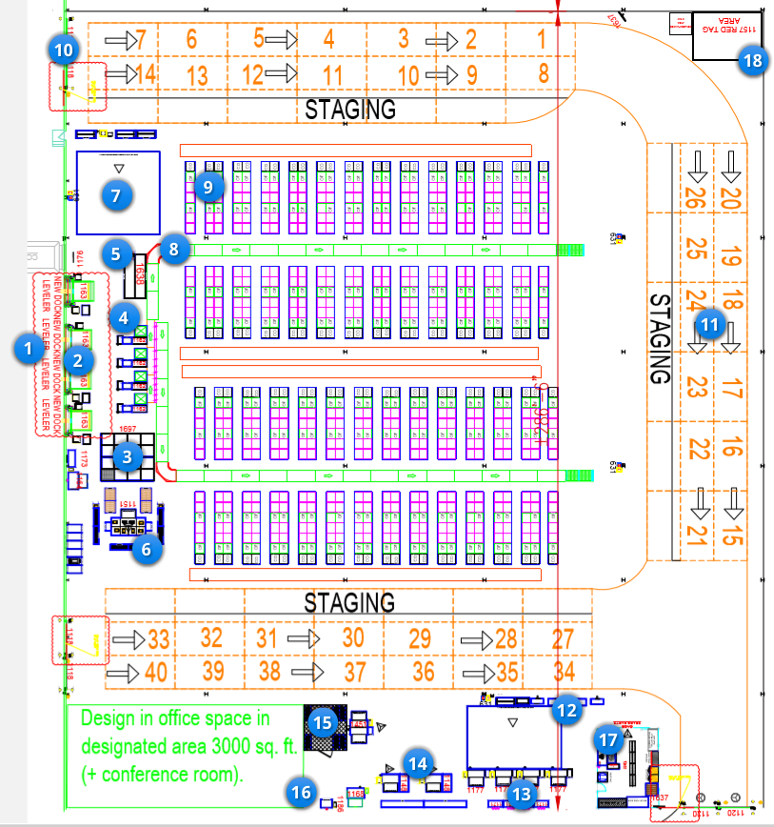


Station Layout and Station Spotlight

Slide 29

Lunch

Slide 30
Station Tour
Important locations around the station

Slide 31
Sortation
How we get packages in their places

Slide 32
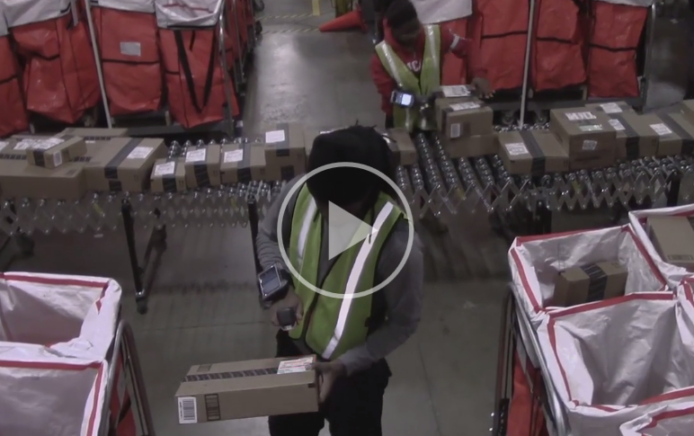
Sortation & Containerization
Notes:
Play the Containerization video and explain that this video is intended to give a basic overview of the general concept of sort, the setup can be different at stations. Point out that the current SOP is when a bag is full, you should close the bag out and move it to a new bag. Only packages with Oversized label on it can be put on the overflow rack.

Slide 33
ZBR / SSP / Containerization
Sortation and Zone Based Routing

Slide 34
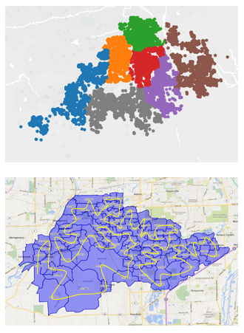
ZBR / SSP / Containerization
Zone based routing and sortation
ZBR/SSP Presentation
Notes:
This ppt has been edited to take out Pick and Stage part.

Slide 35

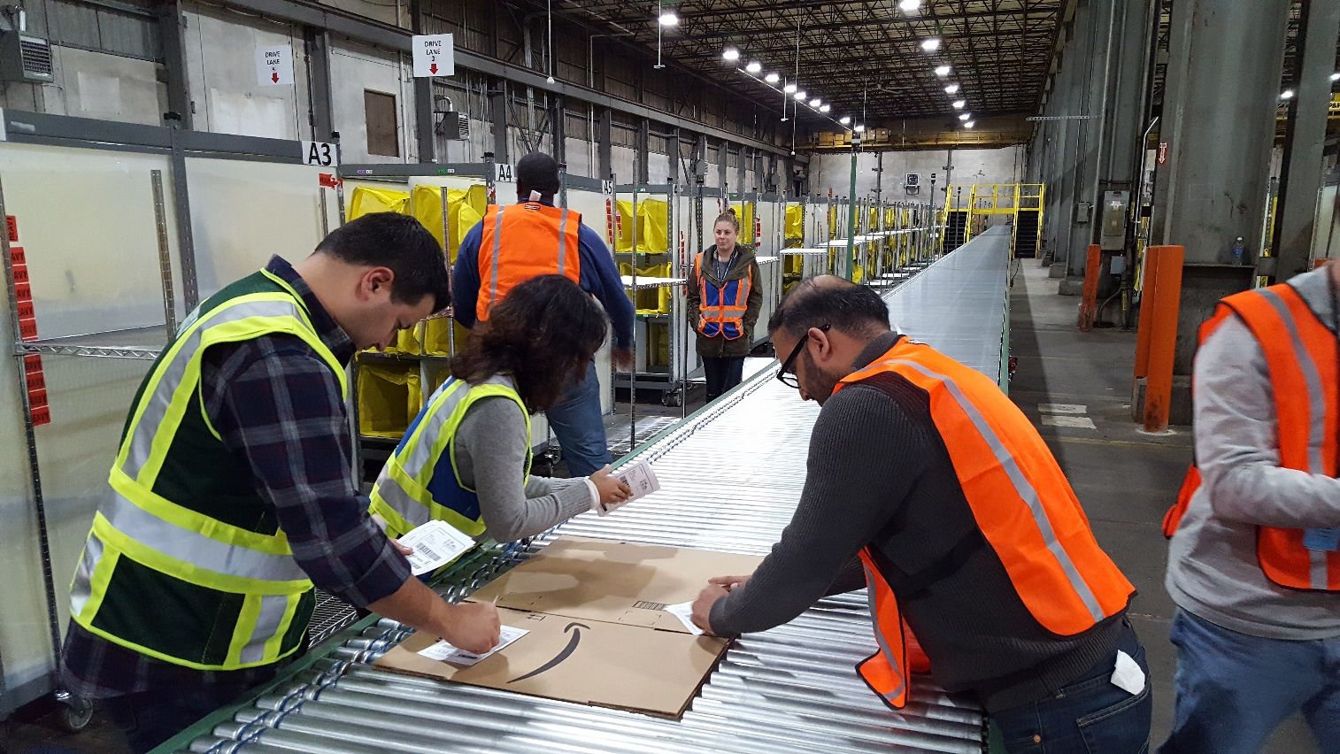
Sortazing Race
Activity
You will have approximately 50 “packages” to sort
You will be sorting all labels as a team
You will be timed
You may only have one package in your hand at a time (one-piece flow)
You may presort if you wish
+:10 for each missort!

Slide 36
A to Z Guide
Your guide to everything AMZL!

Slide 37
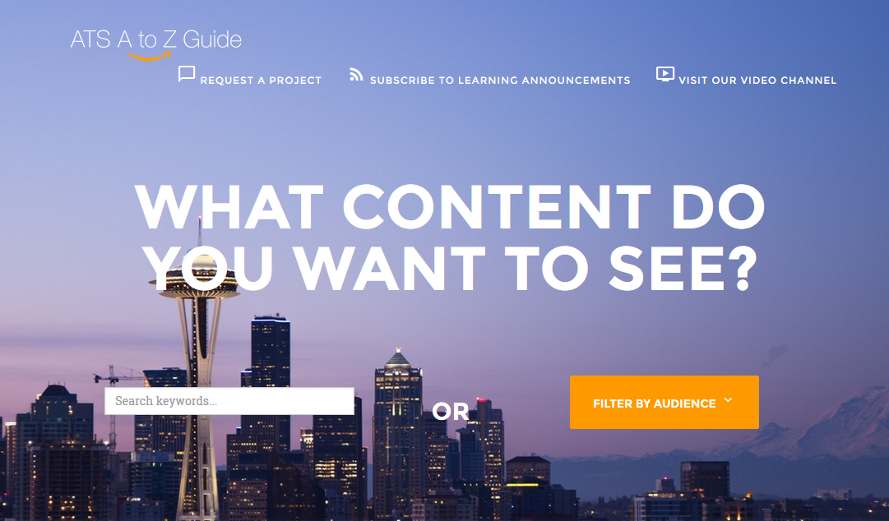
A to Z Guide
Request a project
Subscribe to learning announcements
New announcements / processes / tools
Searchable
Filterable
TMHs, PMVs and other training documents
Updated versions
Versions for Ops, DSPs

Slide 38
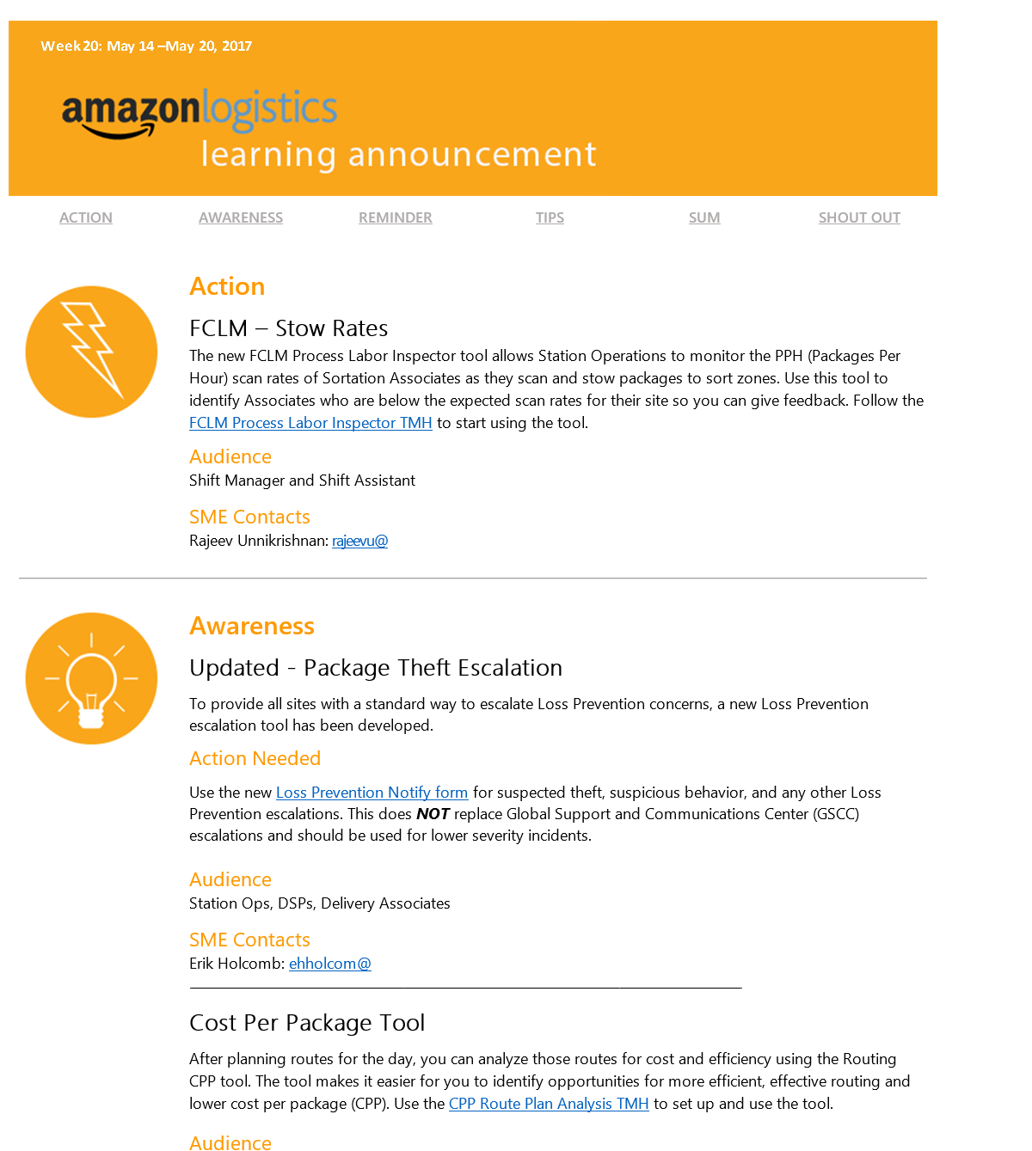
Learning Announcements
Subscribe to the email list
Weekly Learning Announcement call
  Learn new processes from Subject Matter Experts and ask questions
  Updates across the field
  Stand up meeting topics
  Standard work tips
  Shout out
Notes:
Join us for the Weekly Learning Announcement call to learn about new processes from Subject Matter Experts, including updates across the field, Stand Up Meeting topics, and Standard Work Tips for your Delivery Stations. Scroll down for more information and instructions.

Slide 39
Baseline Station Playbook
Standard work and best practices in AMZL

Slide 40
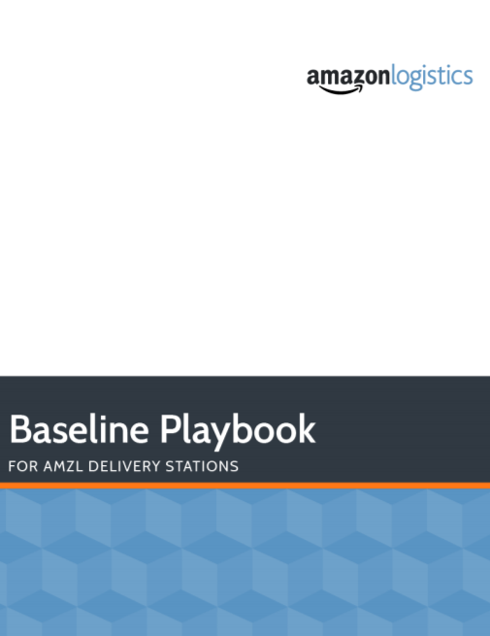
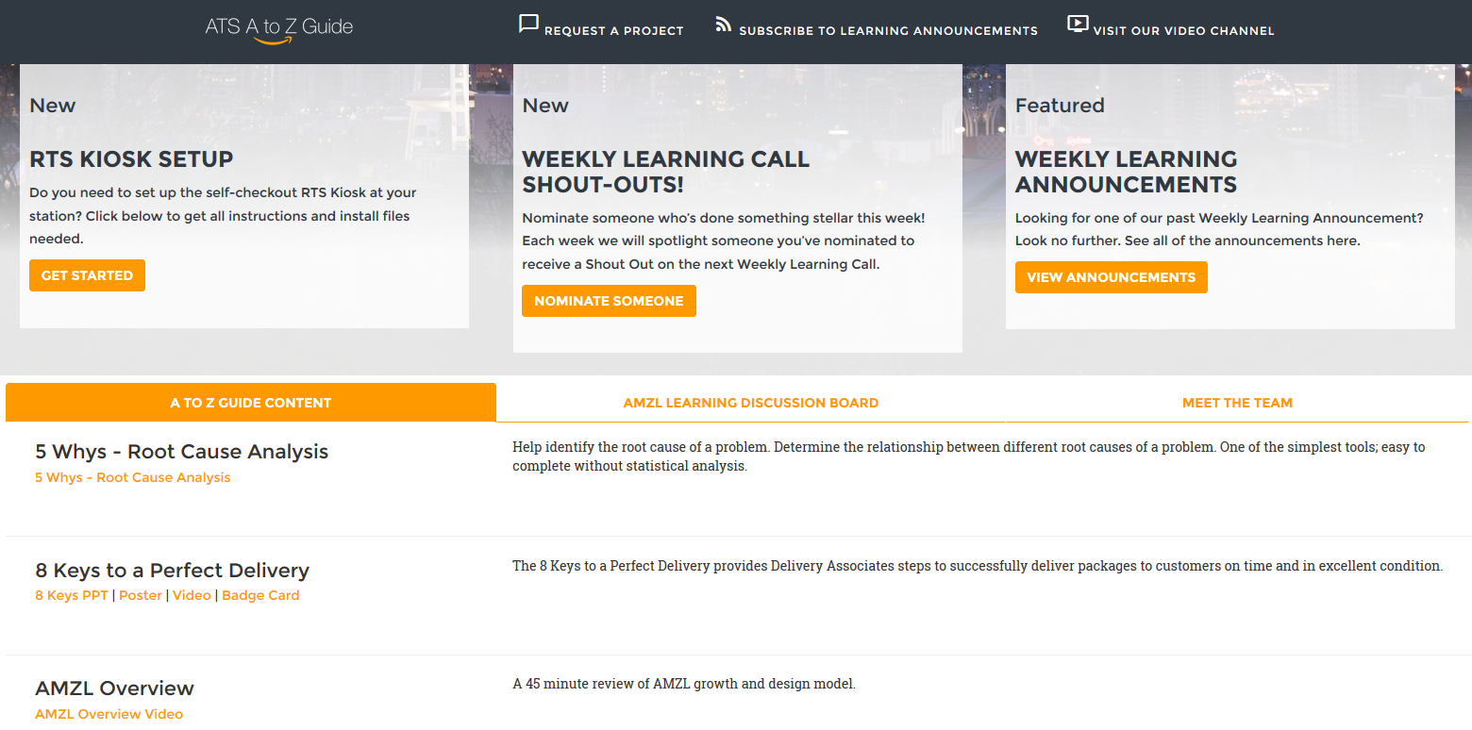
Baseline Playbook & A to Z Guide

Slide 41
Baseline Station Playbook
Refer to the Baseline Station Playbook for standard work and best practices
Consolidates all of the current standards, resources, job aids, and TMHs in one place
Standardized processes for:
  Sort, Pick, and Stage,
  Load-Out and Dispatch,
  On-Road and Return to Station,
  Same Day, and
  Flex
Updated monthly
Notes:
A cross-functional team recently came together to vet existing processes and documentation to ensure they were simple, standard, and scalable across all North American Delivery Stations. This information was used to create a draft of the Baseline Station Playbook, which includes standardized processes for
Sort, Pick, and Stage,
Load-Out and Dispatch,
On-Road and Return to Station,
Same Day, and
Flex
This Playbook consolidates all of the current standards, resources, job aids, and TMHs in one place and is a living document that will be updated once a month.

Slide 42
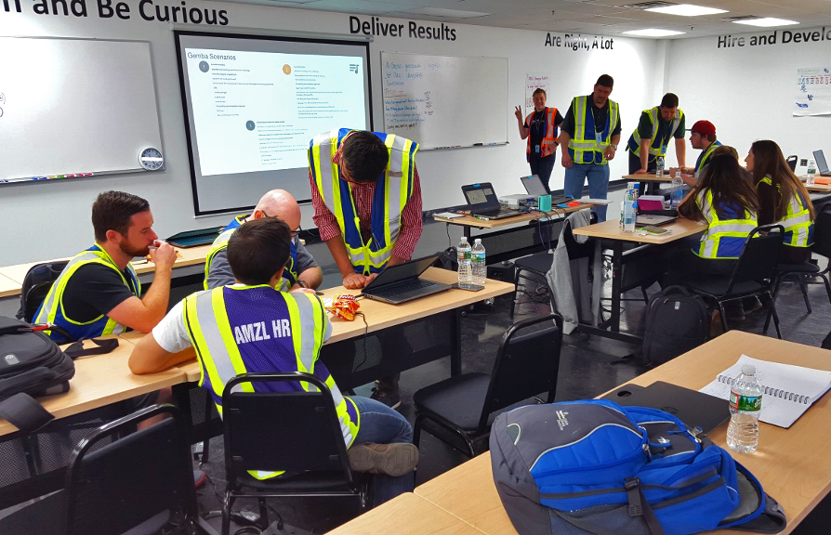
Baseline Station Playbook Activity
Open up the BP
Use the Table of Contents to quickly locate the sections you need to find the answers in
Answer all the questions on the quiz as quickly as possible, but be accurate!
You can work together as a group or split up the questions between you
When you are finished, turn over your paper and let the facilitator know you’re done
Notes:
A cross-functional team recently came together to vet existing processes and documentation to ensure they were simple, standard, and scalable across all North American Delivery Stations. This information was used to create a draft of the Baseline Station Playbook, which includes standardized processes for
Sort, Pick, and Stage,
Load-Out and Dispatch,
On-Road and Return to Station,
Same Day, and
Flex
This Playbook consolidates all of the current standards, resources, job aids, and TMHs in one place and is a living document that will be updated once a month.

Slide 43

Homework
Homework:
Think about questions you would like to ask the Station Manager
DA eLearning curriculum – MUST complete before Ride Along
Notes:
Mention that they can finish the courses during lunchtime on Day 2

